Slide 1
ICAJ/PAB - Improving Compliance with International Standards on Auditing
Planning an audit of financial statements
19 July 2014

Slide 2
Agenda
ISA 300 – Planning an audit of financial statements
Scope and summary
Requirements
Audit programs
Key takeaways

Slide 3
ISA 300 Scope and summary
Scope
Addresses the auditors’ responsibility to plan the audit
Planning audit involves establishing the overall audit strategy for the engagement
Benefits of planning:
Appropriate attention paid to important areas of audit
Auditor is able to identify and resolve potential problems on a timely basis

Slide 4
ISA 300 Scope and summary
Benefits of planning (continued):
Auditor is properly organised and manages the audit engagement so that is it performed in an effective and efficient manner
Audit engagement team members assigned based on levels of capabilities and competence to respond to anticipated risks
Facilitates the direction and supervision of team

Slide 5
Requirements of ISA 300
Involvement of key engagement team members
All key personnel must be involved in planning audit
Allows for team to draw on each others’ experience and insight
A meeting is usually sufficient
Recommended that auditor document the key points of this meeting

Slide 6
Requirements of ISA 300
Preliminary engagement activities
Client or engagement acceptance / continuance
Assess compliance with ethical requirements including independence (ISA 220)
Establish an understanding of terms of engagement (ISA 210)
PM 1 has example independence confirmation checklist and client acceptance/continuance checklist
Notes:
For initial engagements – may have to conduct more procedures including discussions with predecessor auditors

Slide 7
Requirements of ISA 300
Planning activities
Auditor should establish the overall audit strategy that sets the scope, timing and direction of audit and that guides the development of the audit plan

Slide 8
Requirements of ISA 300
Audit strategy –
Characteristics of engagement that define its scope
Ascertain the reporting objectives of the engagement to plan the timing of the audit
Identify which factors are directing the engagement team’s efforts
Should consider the results of the preliminary engagement activities
Determine NTE of resources
Notes:
Who to deploy? Are more experienced team members needed? Do I need a specialist or expert on this engagement?
How many team members required? When are they required? What did we agree with the client?
Will the audit be conducted in only on phase? Is there is an interim audit?
For smaller entities, the entire audit may be conducted by a very small audit team. Those audits may involve an engagement partner working with one team member or no team members.
Expectation is that communication should be easier.
Establishing the audit strategy should not be a complex or time consuming exercise for small entities
A brief memorandum prepared at the completion of the prior year’s audit based on a review of the working papers and highlighting issues identified in the audit updated in the curren period based on discussions with management can serve as the current audit engagement if it covers the matters noted on this slide

Slide 9
Requirements of ISA 300
Audit plan –
Auditor to develop a plan that outlines:
Nature, timing and extent of planned risk assessment procedures
Nature, timing and extent of planned further audit procedures at the assertion level
Auditor expected to update and change the overall audit strategy and audit plan as necessary during the course of the audit.

Slide 10
Requirements of ISA 300
Audit plan –
Is more detailed than the overall strategy
Nature, timing and extent of the direction and supervision of team members and review of their work will vary depending factors such as :
size and complexity of entity
area of audit
assessed risk of misstatement
competency of team

Slide 11
Requirements of ISA 300
Audit plan for audits of smaller entities
If audit is carried out entirely by engagement partner, no review issues exist. In this instance, engagement partner having personally conducted all aspects of work will be aware of all material issues.
Forming an objective view on the appropriateness of the judgements made in the course of the audit can present practical problems when the same individual also performs the entire audit. If particularly complex or unusual issues are involved, and the audit is performed by a sole practitioner – it may be desirable to consult with other suitably experienced auditors or auditor’s professional body.

Slide 12
Requirements of ISA 300
Audit plan for audits of smaller entities
A brief memorandum may serve as the documented strategy for the audit of a smaller entity.
<PM 2> – Example audit planning agenda topics

Slide 13
Requirements of ISA 300
Documentation
Auditor should include in the audit documentation
Overall audit strategy
Audit plan
Any significant changes made during the audit engagement and reasons for such changes

Slide 14
Requirements of ISA 300
Documentation of the overall audit strategy is a record of the key decisions considered necessary to properly plan the audit and to communicate significant matters to the engagement team.
Documentation
represents the record of the planned nature, timing and extent of risk assessment procedures and further audit procedures
serves as a record of the proper planning of the audit procedures that can be reviewed and approved prior to their performance. Standard audit programs or audit completion checklists tailored as needed to reflect the engagement’s circumstances.
Notes:
Smaller entities
-The audit plan, standard audit programs or checklists may be used provided that they are tailored to the circumstances of the engagement, including the auditors’ risk assessments.

Slide 15
Requirements of ISA 300
Documentation for audits of smaller entities
The audit plan, standard audit programs or checklists may be used provided that they are tailored to the circumstances of the engagement, including the auditors’ risk assessments.
Notes:
Smaller entities
-The audit plan, standard audit programs or checklists may be used provided that they are tailored to the circumstances of the engagement, including the auditors’ risk assessments.

Slide 16
Audit programs
Definition – List of procedures to be performed by audit staff to obtain sufficient, appropriate audit evidence
These procedures are determined after obtaining an understanding of the business and determining the audit strategy. The reflect the understanding of the entity’s systems and may incorporate a mix of test of controls and substantive tests that the auditor intends to perform.

Slide 17
Audit programs
Purpose:
Set of instructions to the audit team
Assist with planning and performing the audit
Means to control and record the proper execution of the audit work
Record of the audit procedures to be adopted – audit objectives, timing, sample size and basis of selection of each criteria
Can be standardized or customised

Slide 18
Audit programs
Benefits
Guides audit staff in executing the audit and defines their responsibilities
Can be used to delegate work for preparers and reviewers
Training tool for junior staff
Evidence of work done
Uniformity of work
Offers flexibility (work can be easily transferred)
Point of reference for future audit or reviews (peer, etc.)

Slide 19
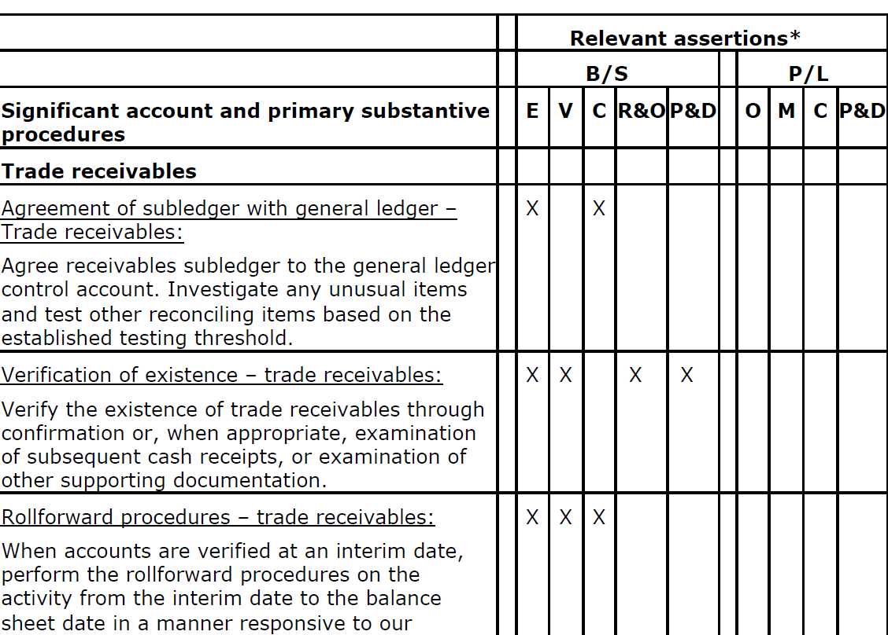
Sample audit program

Slide 20
Audit programs
Must address all financial statement accounts
Based on risk assessments, procedures must address the financial statement assertions
Example: Accounts Receivable
Key assertions?
What procedures to be performed?
When will procedures be performed?

Slide 21
Audit programs
ISA 230 - ‘Audit Documentation’ states that the auditor shall prepare audit documentation that is sufficient to enable an experienced auditor, having no previous connection with the audit, to understand:
(a) The nature, timing and extent of the audit procedures performed to comply with the ISAs and applicable legal and regulatory requirements;
(b) The results of the audit procedures performed, and the audit evidence obtained; and
(c) Significant matters arising during the audit, the conclusions reached thereon, and significant professional judgments made in reaching those conclusions

Slide 22
Key takeaways
Planning an audit is vital to the execution of an efficient and effective audit with sufficient focus placed on the key risk areas
Documentation is a critical responsibility of the auditor to ensure there is appropriate support for the auditors’ opinion that is issued
Audit programs are important in facilitating appropriate and sufficient documentation

Slide 23
Questions?

Slide 24
Thank you!

Slide 25
Ernst & Young Assurance | Tax | Transactions | Advisory
About Ernst & Young Ernst & Young is a global leader in assurance, tax, transaction and advisory services. Worldwide, our 167,000 people are united by our shared values and an unwavering commitment to quality. We make a difference by helping our people, our clients and our wider communities achieve their potential.
Ernst & Young refers to the global organization of member firms of Ernst & Young Global Limited, each of which is a separate legal entity. Ernst & Young Global Limited, a UK company limited by guarantee, does not provide services to clients. For more information about our organization, please visit www.ey.com.
About Ernst & Young’s Assurance Services Strong independent assurance provides a timely and constructive challenge to management, a robust and clear perspective to audit committees and critical information for investors and other stakeholders. The quality of our audit starts with our 60,000 assurance professionals, who have the experience of auditing many of the world’s leading companies. We provide a consistent worldwide audit by assembling the right multidisciplinary team to address the most complex issues, using a proven global methodology and deploying the latest, high-quality auditing tools. And we work to give you the benefit of our broad sector experience, our deep subject matter knowledge and the latest insights from our work worldwide. It’s how Ernst & Young makes a difference.
© 2013 Ernst & Young. All Rights Reserved.

